Slide 1
DSCI-6003 & DSCI-6004 Final Project Economic News Article Tone and Relevance.
Carles Poles-Mielgo
https://github.com/carlespoles/DSCI6004-student/tree/master/week_8/8_2_final_project/FinalProject-CPM
https://github.com/carlespoles/PyTagCloud

Slide 2
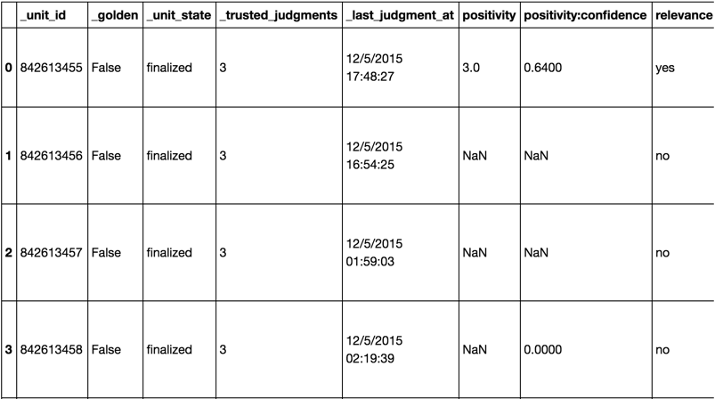
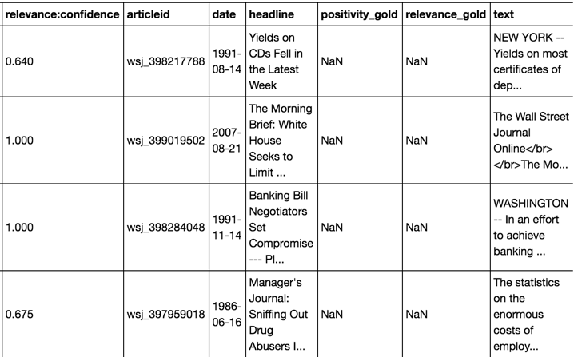
EDA
http://dbgroup.cs.tsinghua.edu.cn/ligl/crowddata/

Slide 3
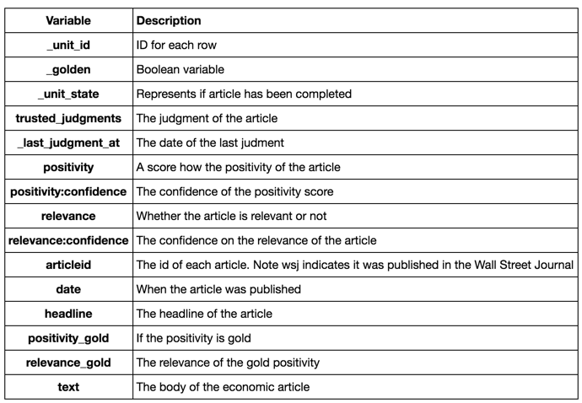
EDA

Slide 4
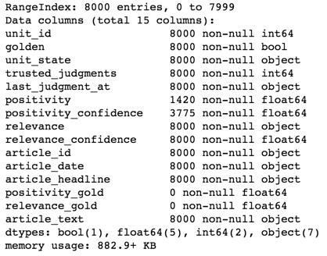
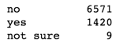
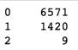
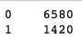
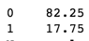
EDA
Using ’relevance’ as labels:
Convert then to numeric:

Slide 5
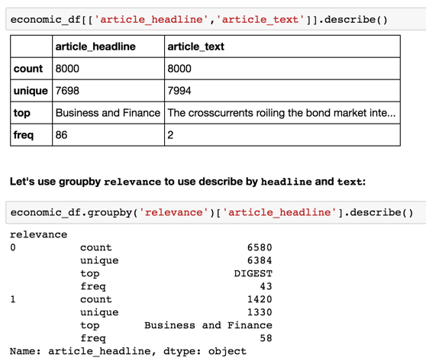
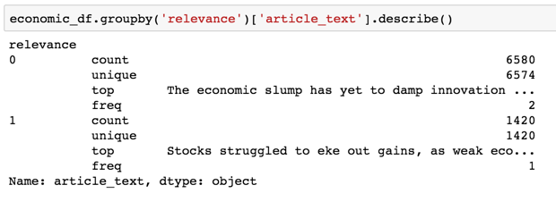
EDA
Our two potential features:

Slide 6
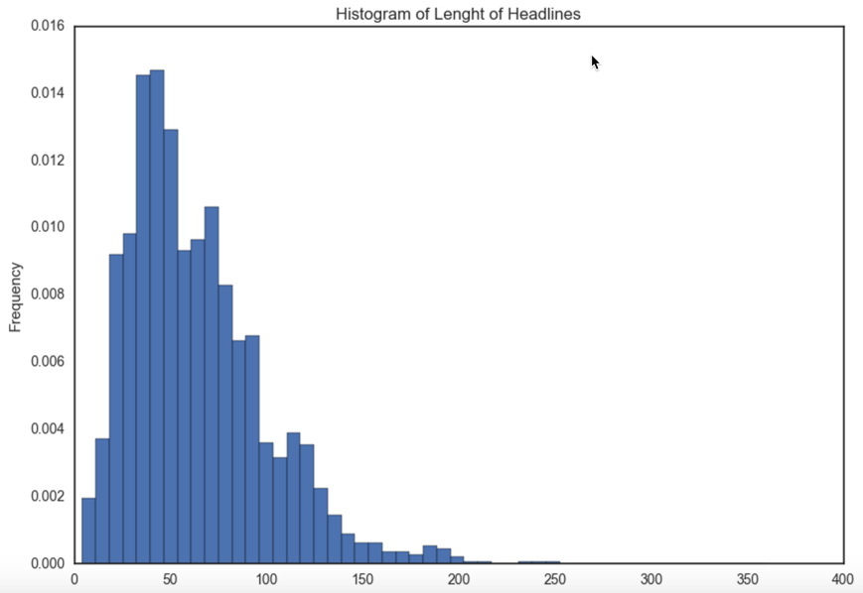
EDA

Slide 7
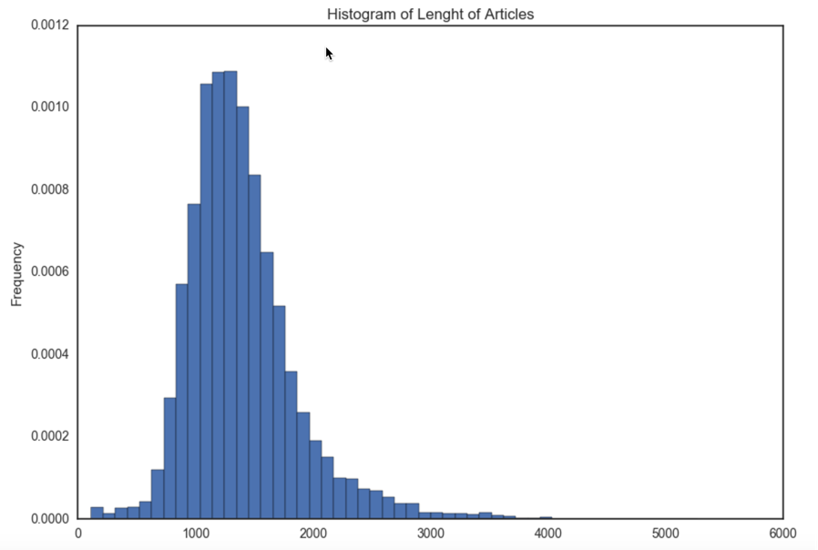
EDA

Slide 8
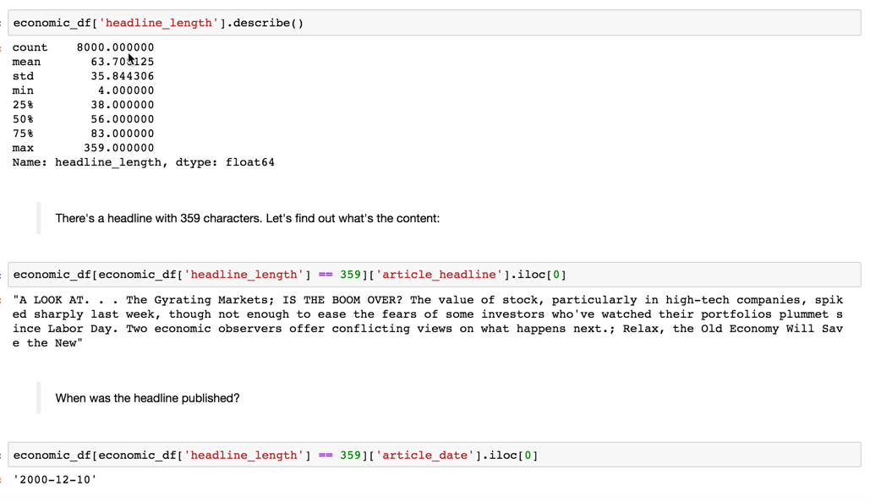
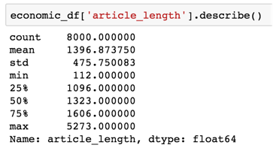
EDA

Slide 9
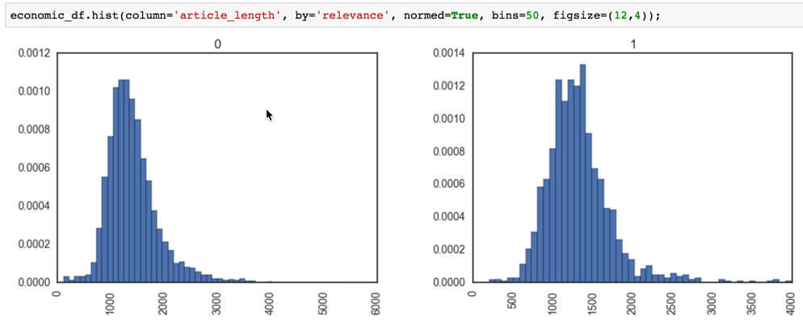
EDA

Slide 10
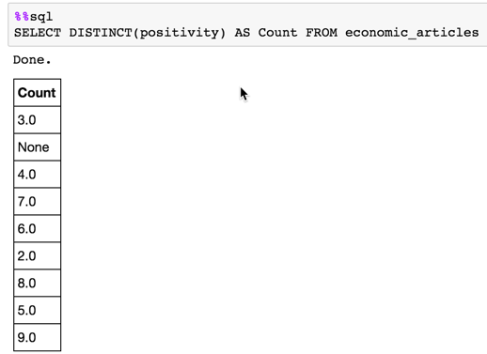
EDA
Using ’positivity’ as labels:

Slide 11
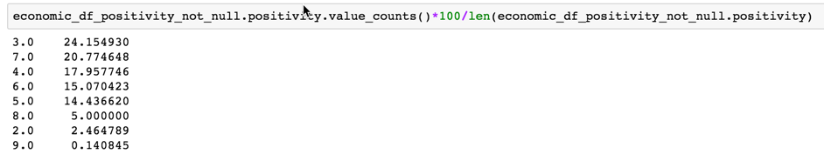
EDA
Using ’positivity’ as labels:

Slide 12
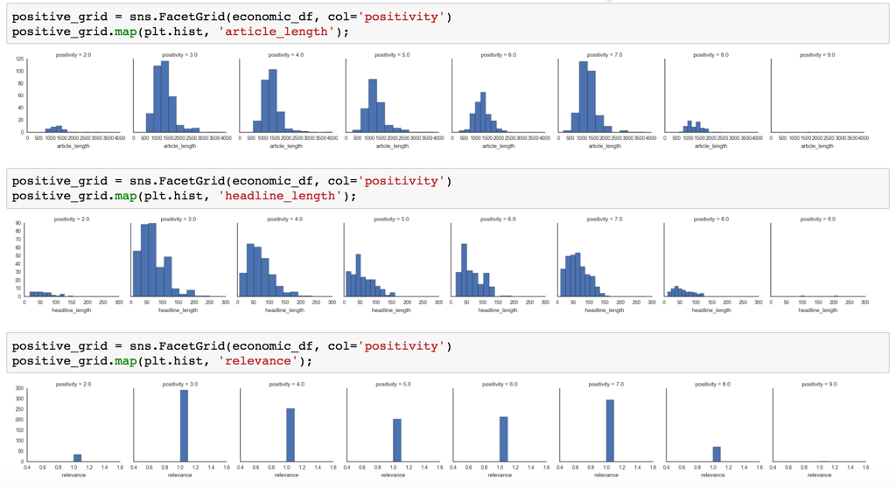
EDA

Slide 13
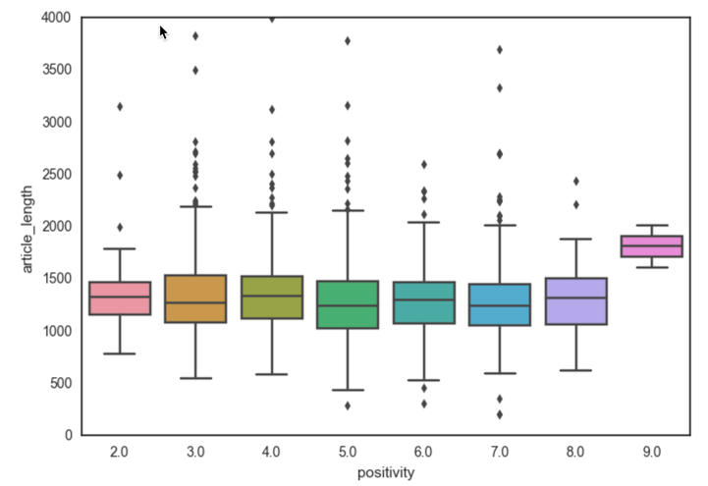
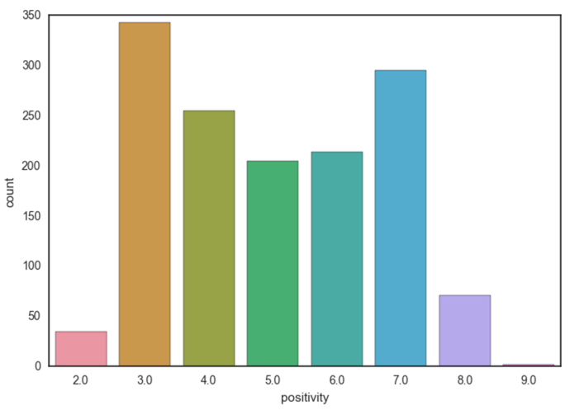
EDA

Slide 14
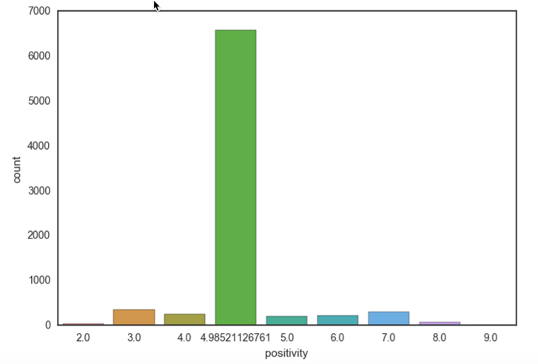
EDA
Not a great idea:

Slide 15
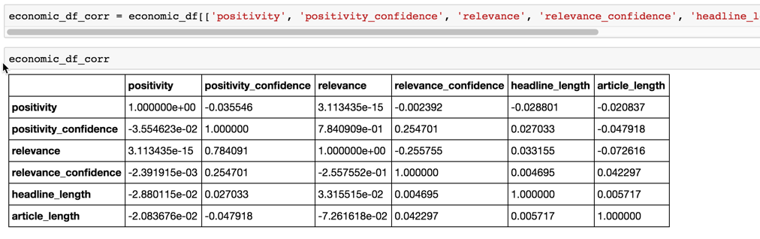
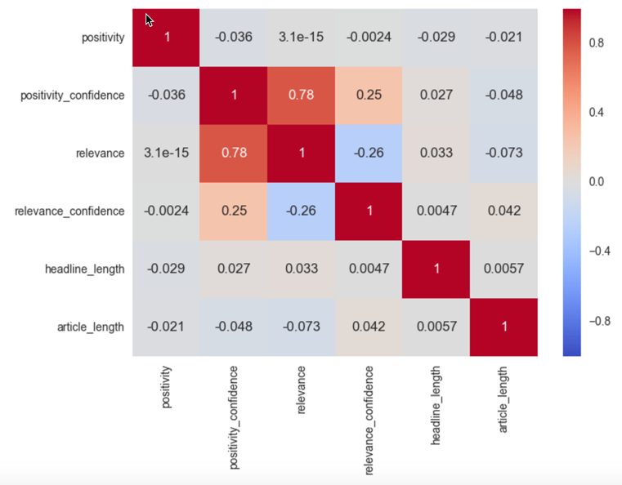
EDA

Slide 16
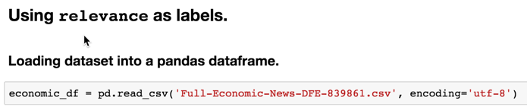
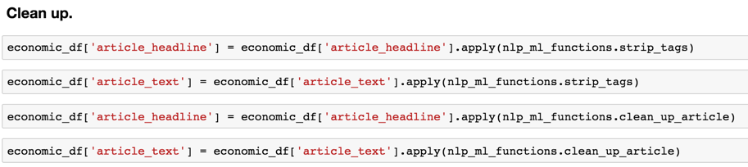
Creating dataframes and cleanup

Slide 17
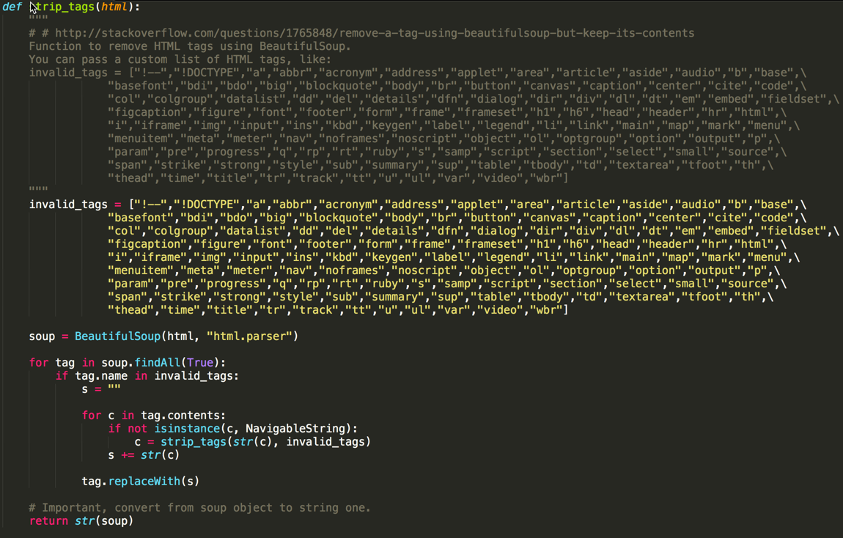
Creating dataframes and cleanup

Slide 18
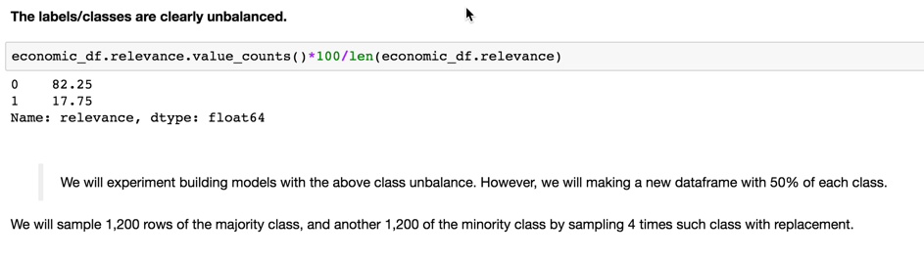
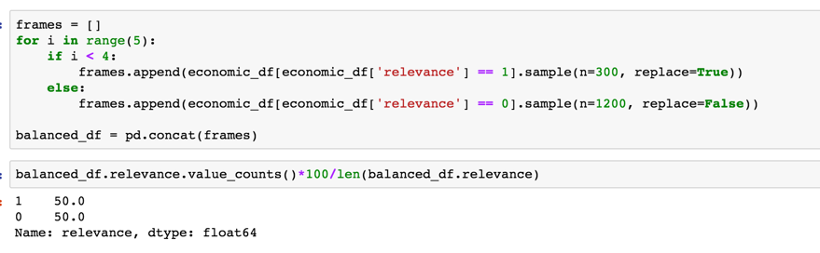
Creating dataframes and cleanup

Slide 19
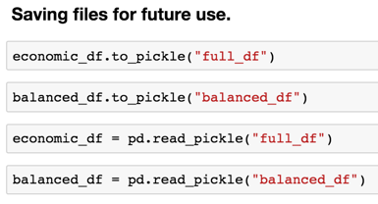
Creating dataframes and cleanup

Slide 20
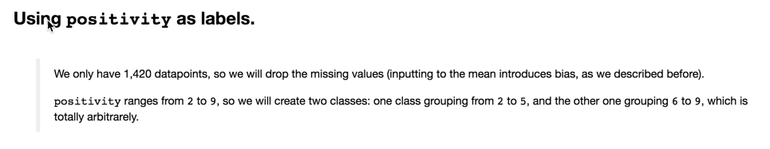
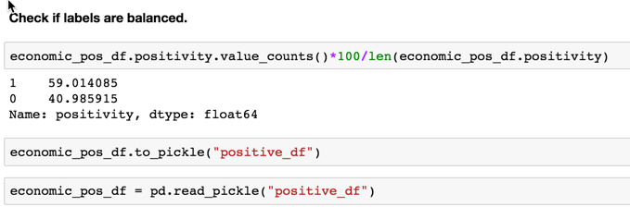
Creating dataframes and cleanup

Slide 21
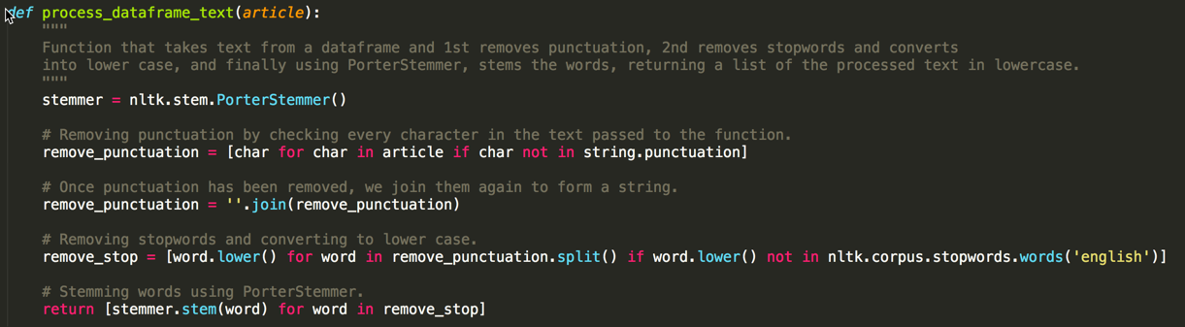
CHOOSING TEXT PROCESSING and features

Slide 22
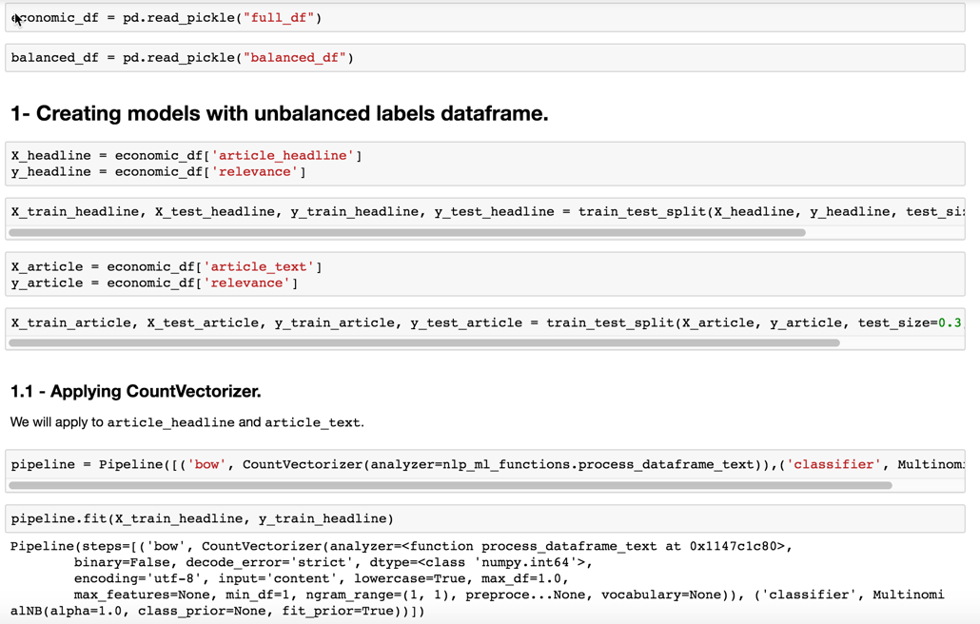
CHOOSING TEXT PROCESSING and features

Slide 23
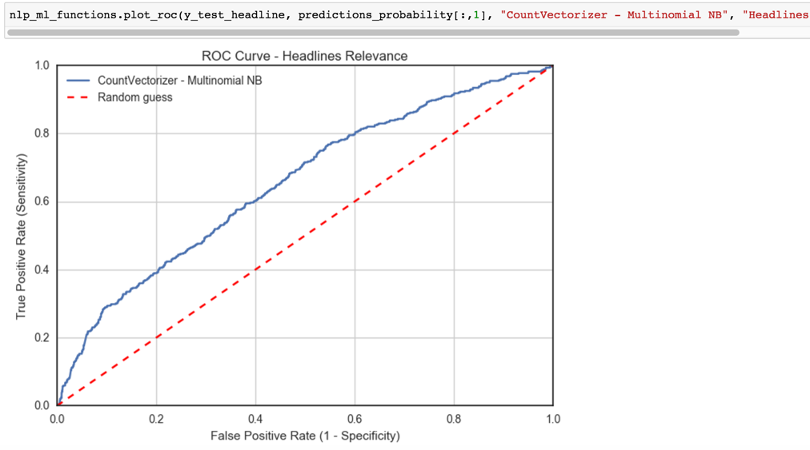
CHOOSING TEXT PROCESSING and features

Slide 24
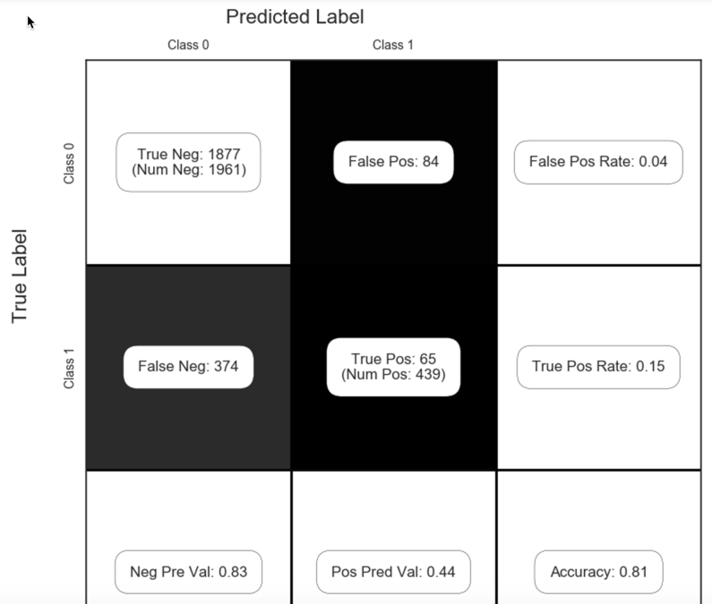
CHOOSING TEXT PROCESSING and features

Slide 25
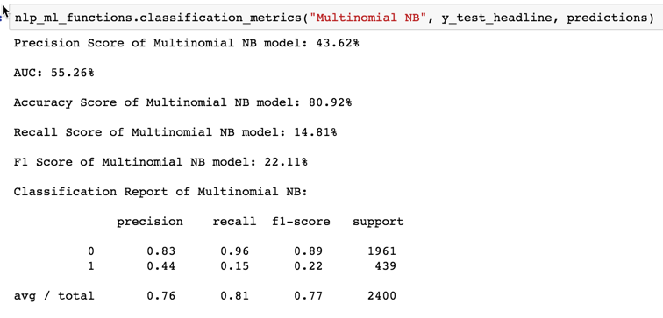
CHOOSING TEXT PROCESSING and features

Slide 26
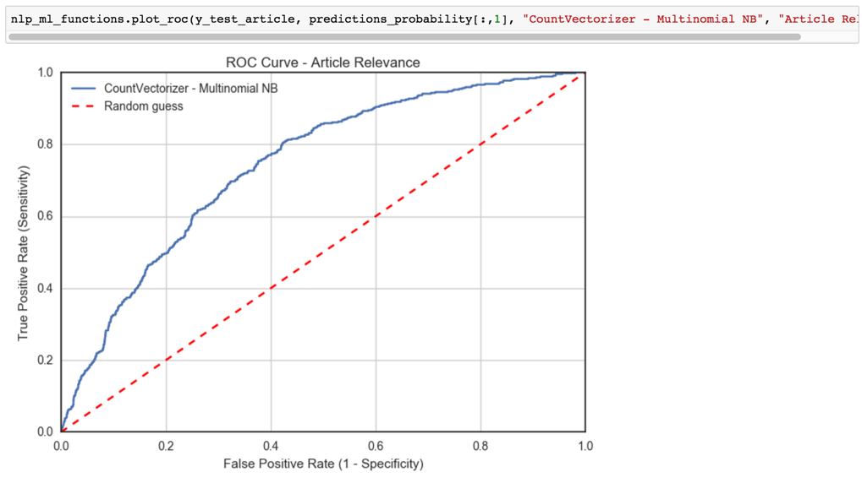
CHOOSING TEXT PROCESSING and features

Slide 27
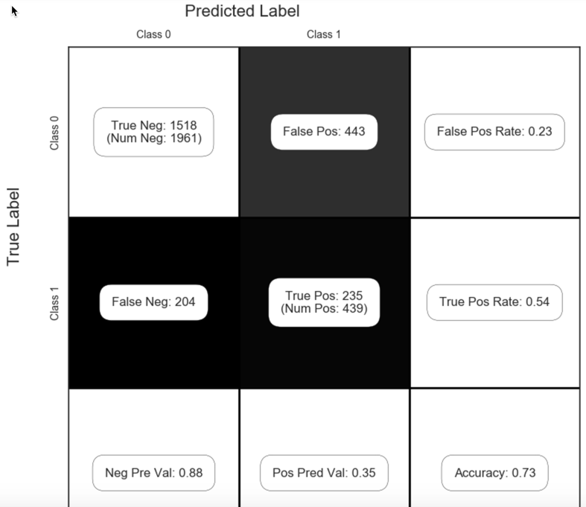
CHOOSING TEXT PROCESSING and features

Slide 28
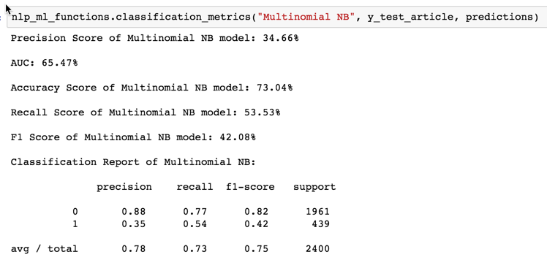
CHOOSING TEXT PROCESSING and features

Slide 29
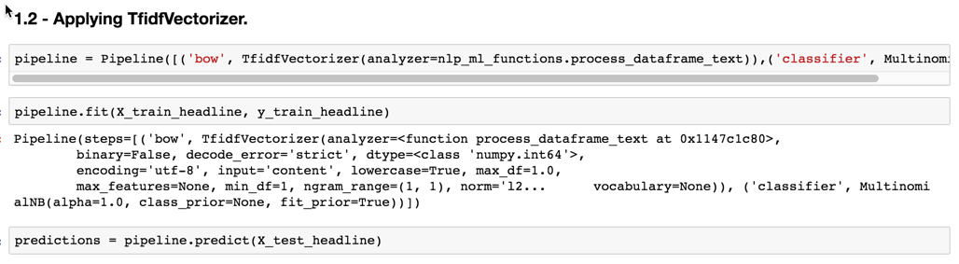
CHOOSING TEXT PROCESSING and features

Slide 30
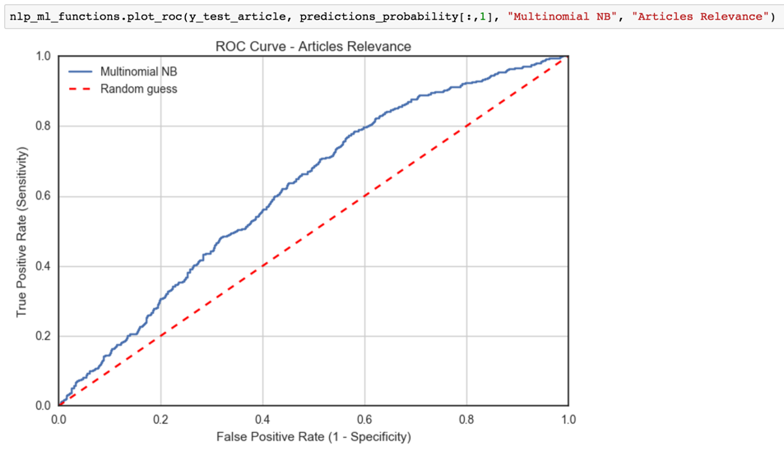
CHOOSING TEXT PROCESSING and features

Slide 31
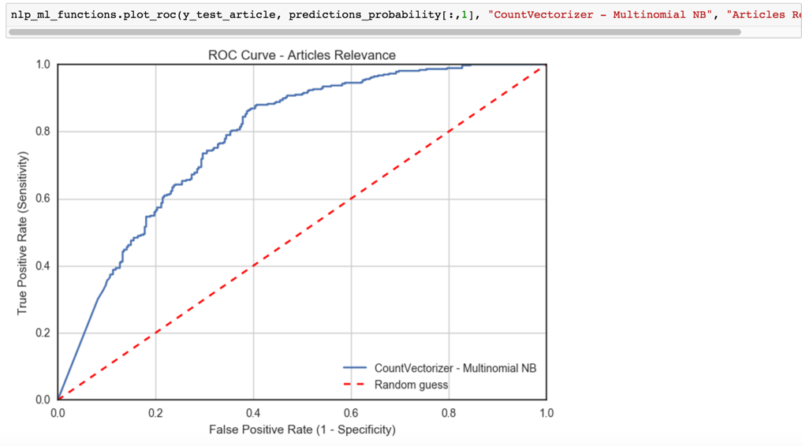
CHOOSING TEXT PROCESSING and features

Slide 32
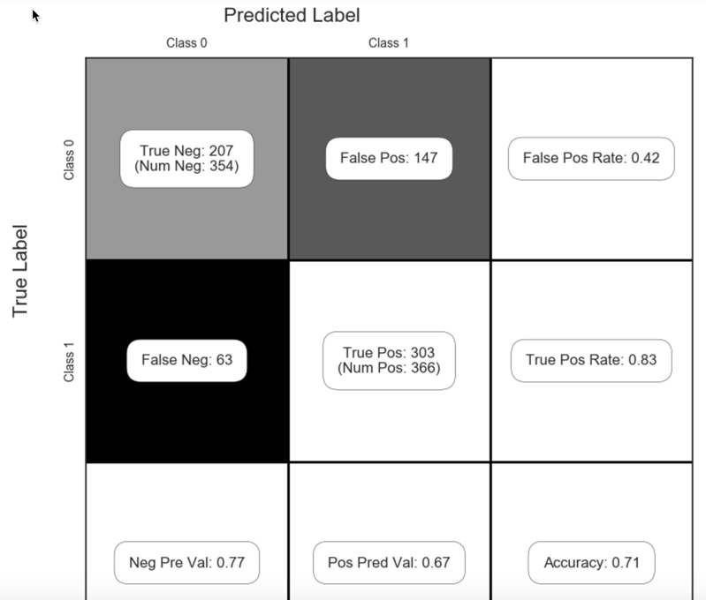
CHOOSING TEXT PROCESSING and features

Slide 33
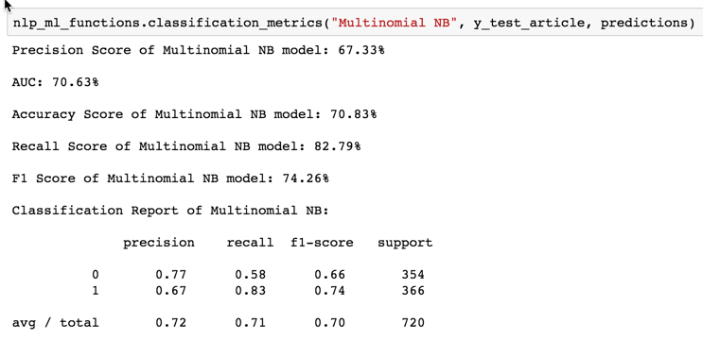
CHOOSING TEXT PROCESSING and features

Slide 34
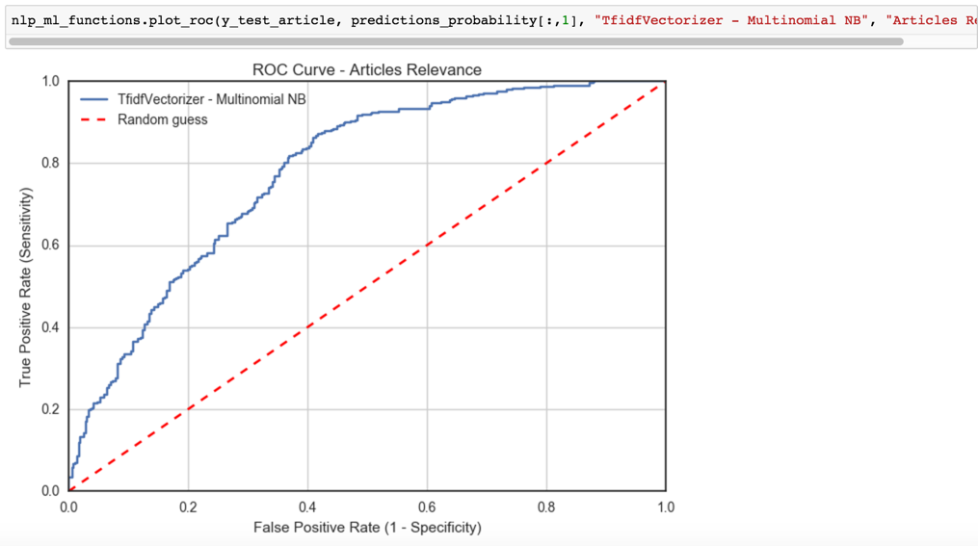
CHOOSING TEXT PROCESSING and features

Slide 35
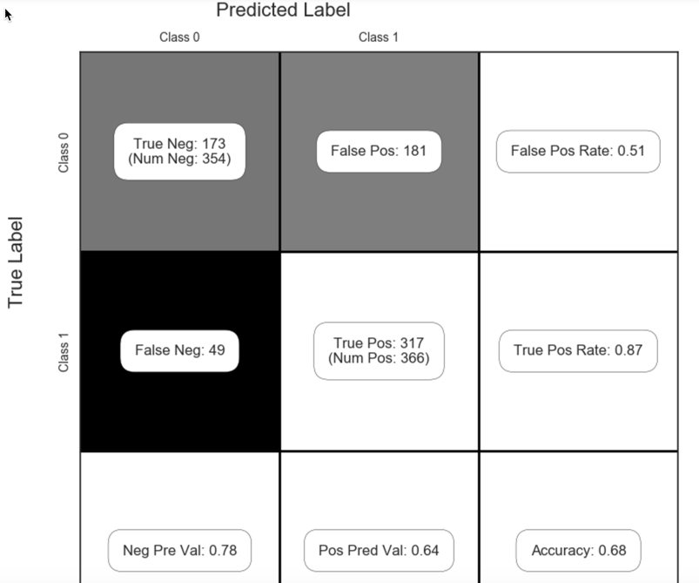
CHOOSING TEXT PROCESSING and features

Slide 36
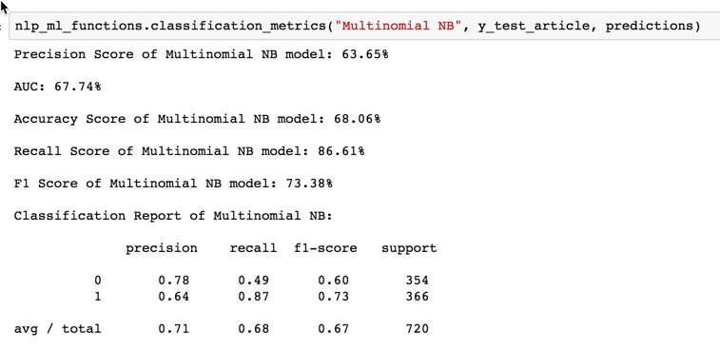
CHOOSING TEXT PROCESSING and features

Slide 37
CHOOSING TEXT PROCESSING and features
Process was repeated for other combinations (e.g. no stem, no stop words, just remove punctuation).
I settled for:
Using the balanced dataset (uses ‘relevance’ as labels).
Using CountVectorizer.
Using Porter stemming and stop words.
Using ‘article_text’ as features.

Slide 38
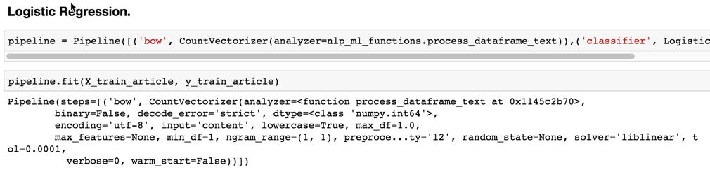
Running default ml models

Slide 39
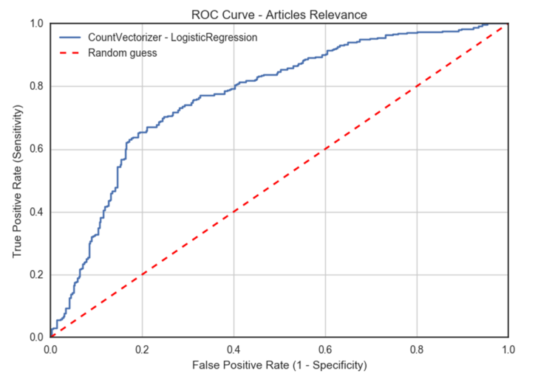
Running default ml models

Slide 40
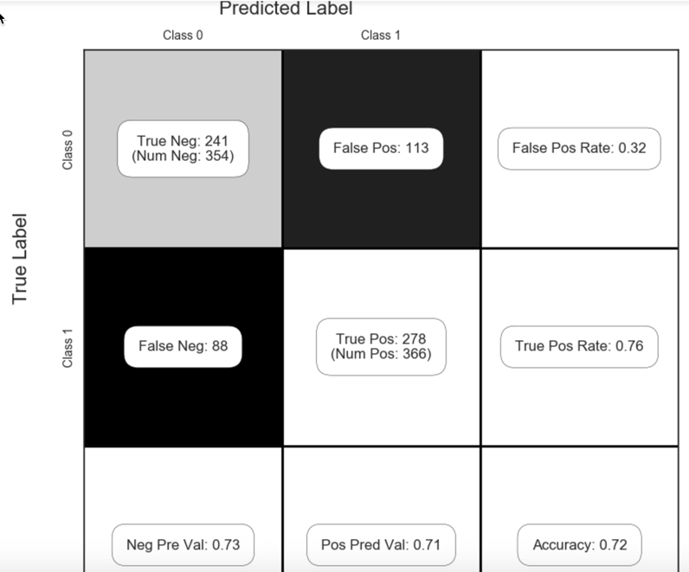
Running default ml models

Slide 41

Running default ml models

Slide 42


Running default ml models

Slide 43

Running default ml models

Slide 44

Running default ml models

Slide 45

Running default ml models

Slide 46

Running default ml models

Slide 47

Running default ml models

Slide 48

Running default ml models

Slide 49

Running default ml models

Slide 50

Running default ml models

Slide 51

Running default ml models

Slide 52


Running default ml models

Slide 53

Running default ml models

Slide 54


Running default ml models

Slide 55


Running default ml models

Slide 56

Running default ml models

Slide 57

Running default ml models

Slide 58

Learning curves
http://scikit-learn.org/stable/auto_examples/model_selection/plot_learning_curve.html

Slide 59

Learning curves

Slide 60


Grid search

Slide 61
Grid search

Slide 62


Grid search

Slide 63

Grid search

Slide 64


Grid search

Slide 65


Grid search

Slide 66


Grid search

Slide 67

Grid search

Slide 68


Grid search

Slide 69


Grid search

Slide 70


Grid search

Slide 71


Grid search

Slide 72


Grid search

Slide 73


Grid search

Slide 74


Grid search

Slide 75


Grid search

Slide 76
Winning model

Slide 77


Word cloud

Slide 78

Word cloud

Slide 79

Word cloud

Slide 80

Word cloud

Slide 81

Word2vec

Slide 82

Word2vec

Slide 83


Word2vec

Slide 84

Word2vec

Slide 85

Word2vec

Slide 86

Word2vec

Slide 87
questions
Biggest challenge: data preprocessing, tuning machine learning hyperparameters.
What did I learn: it is possible to learn from text. Creating balanced sets of data. Use pickle. Naive-Bayes is your best friend.
Skill set to look for: tensorflow expert, machine learning hyperparameter tuning.
Bridging past and future: NLP is not black magic. It’s “just” representing words to numbers.
Tackling the project: a end-to-end lab using word2vec/tensorflow.
Scaling the project: more data, more models/algorithms and more computing “muscle”.
More time for completion: apply tensorflow, better data preprocessing, more hyperparameters tuning, more and better visualizations, write better code.
Making a startup: yes. The ability to pick relevant economical information from the internet to make better investment decisions.
Working in NLP: yes, BUT since I’m more of a generalist, I’m concerned on forgetting the whole “data scientist” picture.

Slide 88


